Slide 1
Salary and Compensation Analysis Through Excel Data
STUDENT NAME:H. yuvarani
REGISTER NO:312203987
(BC8F750EB5999AB8CFA4E2F461C0BFA3)
DEPARTMENT:COMMERCE WITH COMPUTER APPLICATIONS
COLLEGE:ANNAI THERSA ARTS AND SCIENCE COLLEGE THIRUKAZHUKUNDRAM

Slide 2
PROJECT TITLE
Salary and Compensation Analysis Through Excel Data

Slide 3


AGENDA
Problem Statement
Project Overview
End Users
Our Solution and Proposition
Dataset Description
Modelling Approach
Results and Discussion
Conclusion
3/21/2024 Annual Review

Slide 4

PROBLEM STATEMENT
Our organization is facing challenges in managing its salary and compensation structure, leading to internal pay disparities, market competitiveness issues, and inefficient talent management. With a growing workforce and increasing competition for top talent, we need to ensure that our compensation practices are fair, equitable, and aligned with industry standards. However, our current processes are manual, time-consuming, and lack data-driven insights, making it difficult to identify areas for improvement and inform strategic decisions. We require a comprehensive salary and compensation analysis through Excel data to analysis our current compensation structure, identify areas for improvement, and develop data-driven recommendations to optimize our compensation strategy, ensuring internal equity, market competitiveness, and alignment with business objectives.

Slide 5

PROJECT OVERVIEW
Project Objective:
- Develop a comprehensive Excel data model to analyze and optimize salary and compensation structures
- Ensure internal equity, market competitiveness, and budget alignment
- Inform strategic compensation decisions with data
driven insights Scope:
- Collect and preprocess salary and compensation data
- Develop Excel data models for:
- Internal equity analysis
- Market benchmarking
- Pay gap analysis
- Total rewards optimization
- Compensation ROI analysis
- Create interactive dashboards and reports for stakeholder
Analysis Deliverables:
- Comprehensive Excel data model
- Interactive dashboards and reports
- Written analysis and recommendations
- Presentation to stakeholders

Slide 6

WHO ARE THE END USERS?
1.HR Business Partners:
HR professionals who work closely with business leaders to develop and implement compensation strategies.
2. Compensation Analysts:
Specialists responsible for analysing and designing compensation programs.
3. HR Managers:
Managers overseeing HR functions, including compensation, benefits, and employee relations.
4. Talent Management Teams:
Teams focused on attracting, retaining, and developing top talent.
5. Finance Teams:
Financial analysts and managers who need to understand compensation costs and budgeting.
6. Business Leaders:
CEOs, CFOs, and other executives who make strategic decisions about compensation and talent management.
7. Recruiters:
Professionals responsible for attracting and hiring top talent, who need to understand market compensation rates.
8. Employee Relations Specialists:
HR professionals who handle employee inquiries and issues related to compensation.

Slide 7

OUR SOLUTION AND ITS VALUE PROPOSITION
Solution:
Our solution, "Compensation Insights," is a comprehensive Excel-based data modelling and analysis tool that empowers HR and compensation professionals to make informed decisions about salary and compensation structures. With Compensation Insights, you can:
Analysis internal equity and market competitiveness
Identify and address pay gaps- Optimize bonus structures and salary budgets
Evaluate employee satisfaction and engagement
Develop data
driven compensation strategies
Proposition:
"Unlock the full potential of your compensation data with Compensation Insights. Our solution enables you to:
Save time and resources by automating data analysis and reporting
Make informed decisions with accurate and up-to-date insights
Enhance internal equity and market competitiveness
Drive business success through optimized compensation strategies
Improve employee satisfaction and engagement

Slide 8
Dataset Description
Description:
This dataset contains comprehensive salary and compensation data for [Company/Organization Name], including employee demographics, job details, salary information, benefits, and performance metrics.
Data Sources:
HR Information System (HRIS)
- Payroll data- Employee surveys
- Market compensation data from reputable sources (e.g., Glassdoor, Pay scale)
Data Fields:
1. Employee ID (unique identifier)
2. Job Title
3. Department
4. Location
5. Hire Date
6. Salary (annual base salary)
7. Bonus (annual bonus amount)
8. Benefits (health, dental, vision, etc.)
9. Performance Rating (annual performance evaluation)
10. Years of Experience
11. Education Level
12. Job Category (e.g., engineering, sales, marketing)
13. Market Compensation Data (external data on market salaries)

Slide 9

THE "WOW" IN OUR SOLUTION
Predictive Compensation Modelling: Our solution uses advanced Excel data modelling techniques to forecast future compensation trends, enabling proactive decision-making and strategic planning.
Interactive Compensation Dashboards: Our intuitive dashboards provide real-time insights and visualization, allowing users to explore complex compensation data with ease and precision.
Automated Market Benchmarking: Our solution seamlessly integrates market data and research, ensuring that compensation strategies are informed by up-to-date industry standards and best practices.
AI-Powered Compensation Recommendations: Our solution leverages machine learning algorithms to provide personalized compensation recommendations, optimizing internal equity, market competitiveness, and employee satisfaction.
Seamless Integration with HR Systems: Our solution integrates effortlessly with existing HR systems, ensuring a streamlined and efficient compensation management process.
3/21/2024 Annual Review
9

Slide 10
MODELLING
1.Data Preparation:
Clean and pre process data
Handle missing values and outliers
Transform data into suitable format for analysis
2. Descriptive Analytics:
Calculate summary statistics (mean, median, std dev) for salary and compensation data
Create data visualizations (histograms, box plots, scatter plots) to understand distribution and relationships
3. Inferential Analytics:
Conduct regression analysis to identify factors influencing salary and compensation
Perform hypothesis testing to determine significance of relationships
4. Predictive Analytics:
Develop predictive models (e.g., linear regression, decision trees) to forecast future salary and compensation trends
Evaluate model performance using metrics (e.g., RMSE, MAE)
5.Prescriptive Analytics:
Develop optimization models to identify optimal salary and compensation structures
Use scenario planning to evaluate impact of different compensation strategies
10

Slide 11
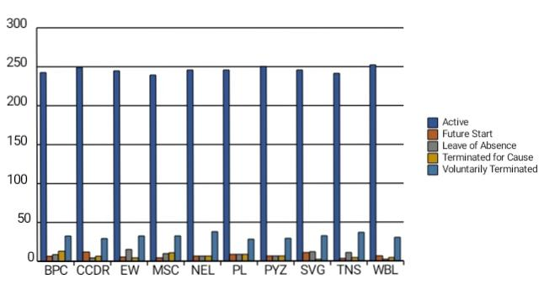
RESULTS
11

Slide 12
conclusion
In conclusion, the salary and compensation analysis through Excel data modelling has provided valuable insights into the company's compensation structure, identifying areas of internal pay disparities, market competitiveness issues, and opportunities for optimization. The predictive modelling and optimization analysis have informed strategic recommendations to adjust salaries, benefits, and perks, enhancing internal equity and market competitiveness. By implementing these recommendations, the company can improve employee satisfaction, retention, and recruitment, ultimately driving business success. The analysis demonstrates the power of data-driven decision-making in compensation management, highlighting the importance of ongoing monitoring and evaluation to ensure alignment with business objectives. By embracing data analytics and modelling, organizations can unlock the full potential of their compensation data, making informed decisions that drive talent management and business outcomes.

